Slide 1
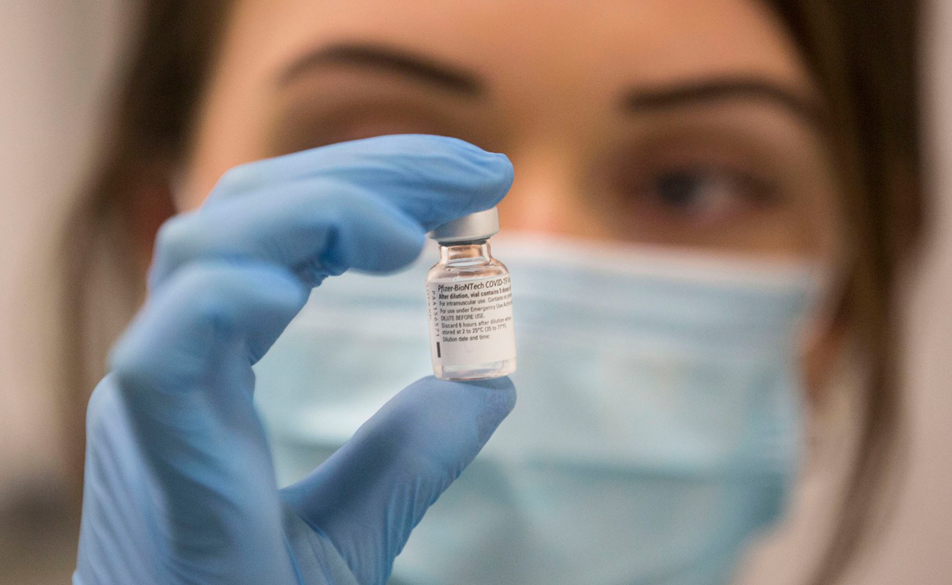
SQL Assignment
COVID-19 vaccination delivery
Liran Israeli, sapir sherman

Slide 2
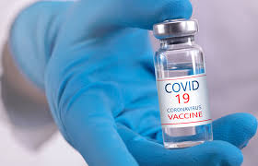
The Health maintenance organization (HMO) handles a lot of information, such as data on the population, employees, supply of vaccines, and the connections between them. Every citizen who makes a call to the HMO does so to make an appointment. When a citizen calls the HMO, an HMO employee takes his/her details: including: ID, name, and phone number. Then, the employee checks to see when there is an upcoming free appointment and schedules it .
General description

Slide 3
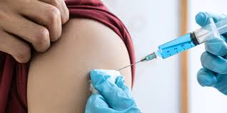
“VACCINES C19“ We are developing a management system that manages the data of the Health maintenance organization following the arrival of the vaccines. Our goal is to manage a system for delivery of the vaccines to the population of a small town. To make this happen, the software provides data analysis about the supply of vaccines and their availability to citizens.
Requirements for the system

Slide 4

users
There are 2 types of users in “VACCINES C19”:
Health maintenance organization – will use the system to connect between the supply of vaccines and their availability to citizens. They will have all the details about the citizens, including medical files.
supplier– will use the system to deliver the vaccines at the scheduled delivery time.

Slide 5
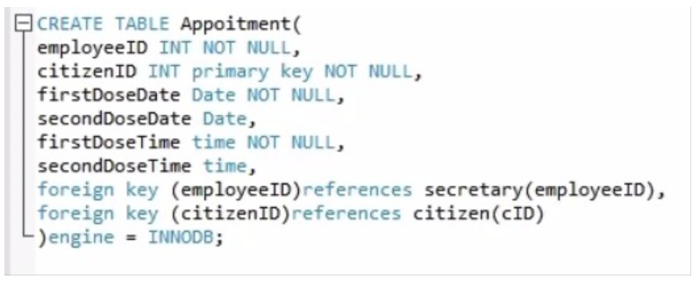
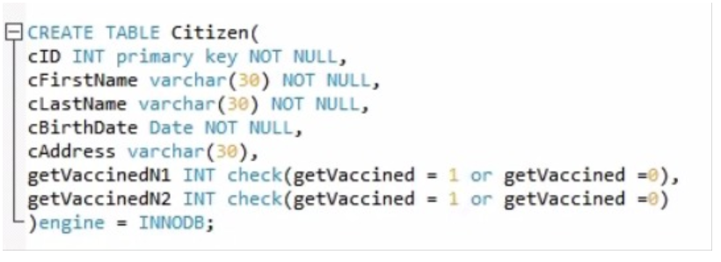
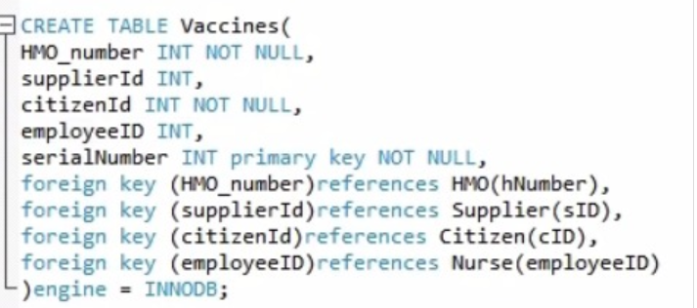
Create tables

Slide 6
sName
eFirstName
eLastName
sID
sAddress
ERD
sPhoneNumber
eID
eName
Supplier
ePhoneNumber
Phone
Name
Address
1
Employee
Work at
N
Hnumber
supply
1
serialNumver
HMO
1
ISA
transferred to
N
N
Vaccines
Secretary
Nurse
1
injects
N
N
1
cFirstName
cLastName
Can get
schedule
cBirthDate
cAddress
firstDoseDate
cName
secondDoseDate
N
1
Appoitment
has
Citizen
getVaccinedN1
N
1
firstDoseTime
cID
cPhoneNumber
getVaccinedN2
secondDoseTime

Slide 7
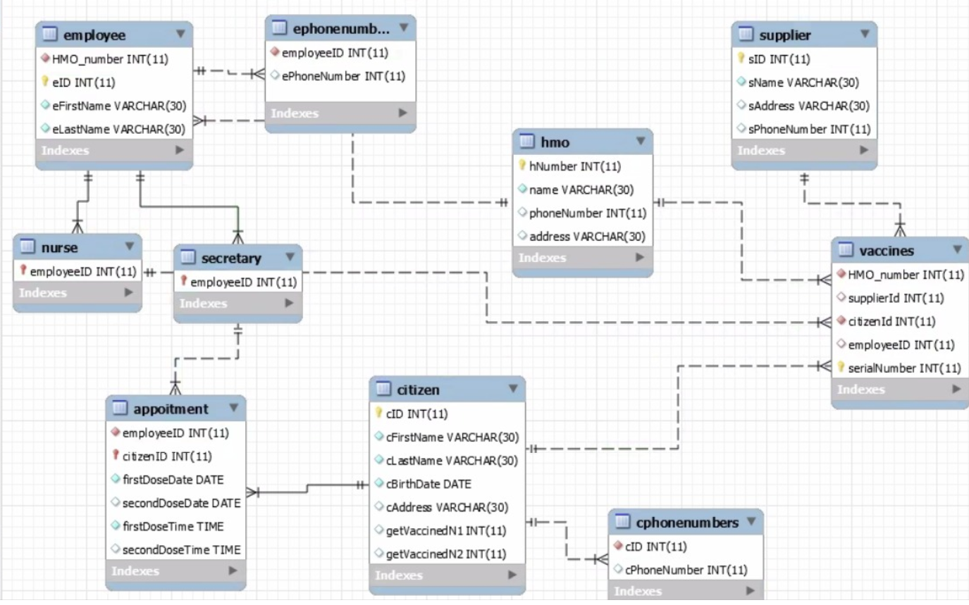

Slide 8
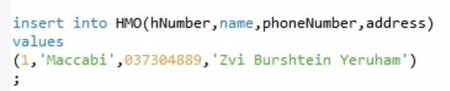
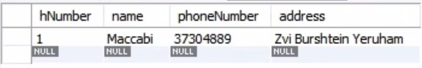
Insert into tables:

Slide 9
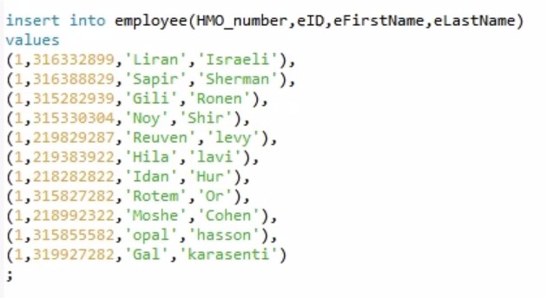
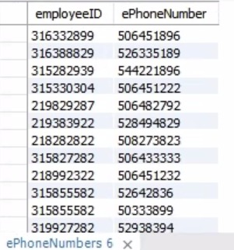
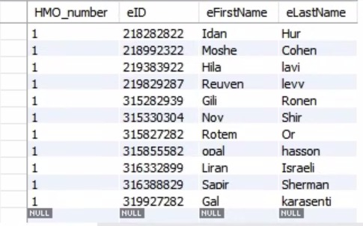
Insert into tables:

Slide 10
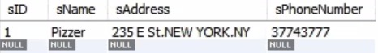
Insert into tables:

Slide 11
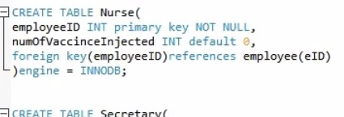
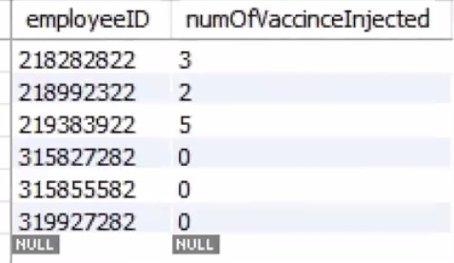
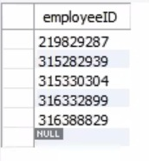
Insert into tables:

Slide 12
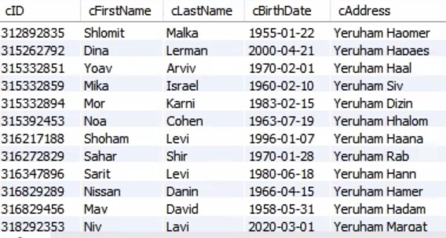
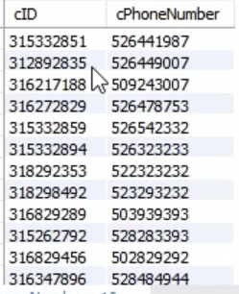
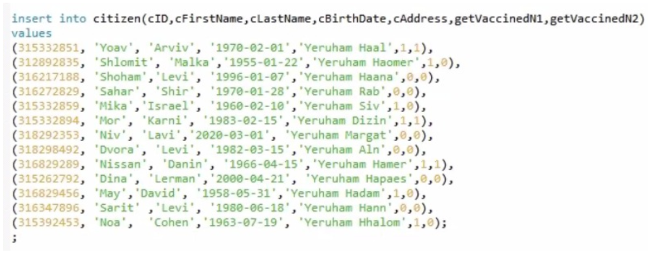
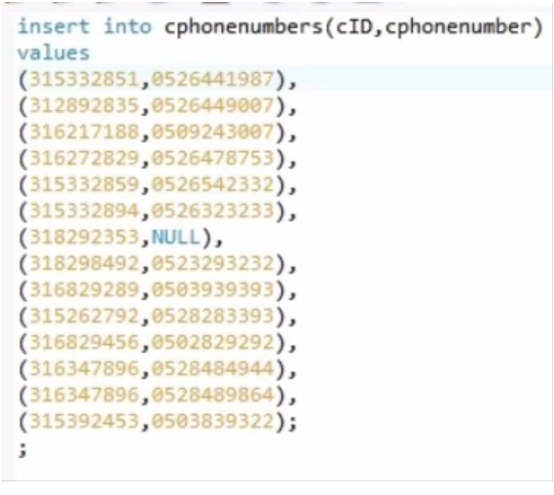

Slide 13
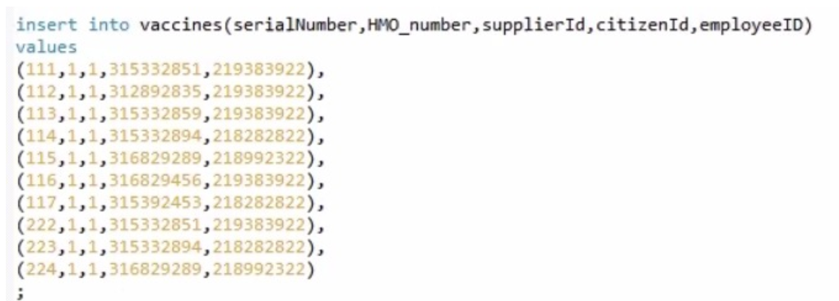
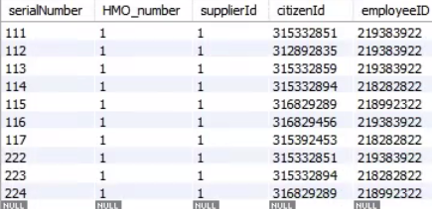

Slide 14
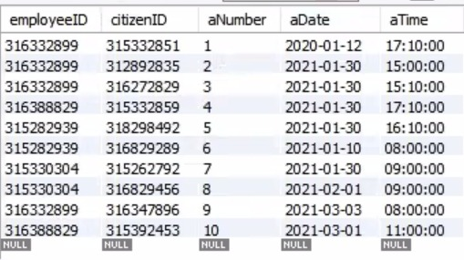

Slide 15
Queries
Number of citizens who took the first dose of vaccination
Number of citizens who took the second dose of vaccination
Number of citizens who didn’t get vaccinated at all (yet)
Show citizens list from age 60 or older
Show appointment list of a specific day for first dose date
How many vaccine doses were injected by a specific nurse?
Average of people who got vaccinated from the entire city population
How many vaccines were given by the HMO?
The date of the second vaccine dose for a specific citizen
The nurse that had injected the most vaccine doses
How many appointments were scheduled by a specific secretary?
The secretary who scheduled the most appointments

Slide 16
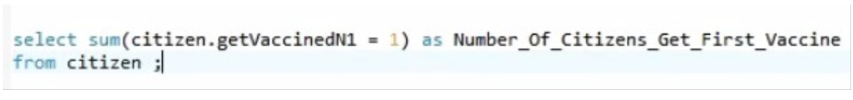
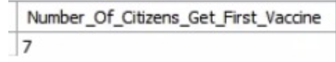
Queries
Number of citizens who took the first dose of vaccination

Slide 17
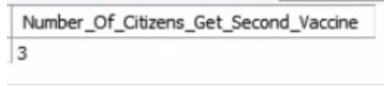
Queries
2) Number of citizens who took the second dose of vaccination

Slide 18
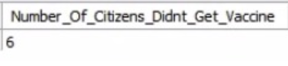
Queries
3) Number of citizens who didn’t get vaccinated at all (yet)

Slide 19
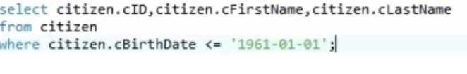
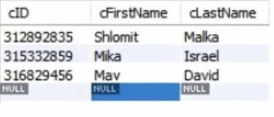
Queries
4) Show citizens list from age 60 or older

Slide 20
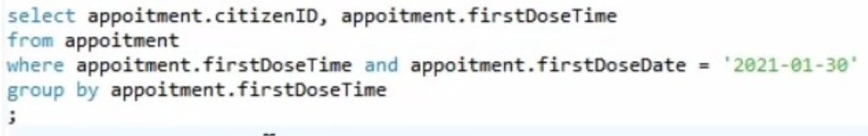
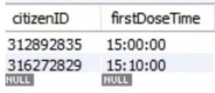
Queries
5) Show appointment list of a specific day for first dose date

Slide 21
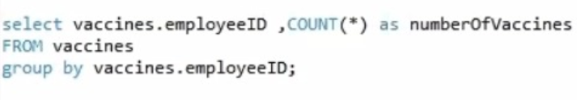
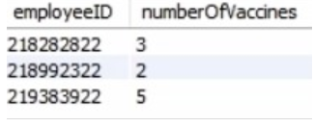
Queries
6) How many vaccine doses were injected by a specific nurse?

Slide 22
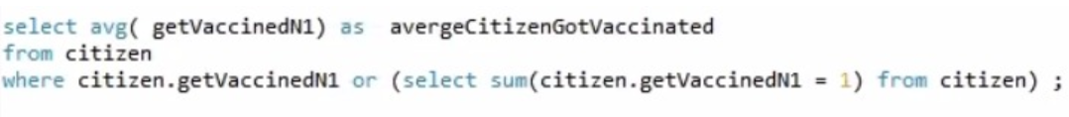
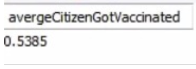
Queries
7) Average of people who got vaccinated from the entire city population

Slide 23
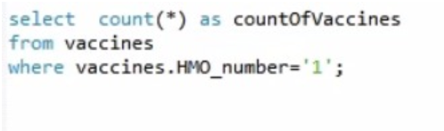
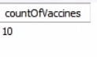
Queries
8) How many vaccines were given by the HMO?

Slide 24
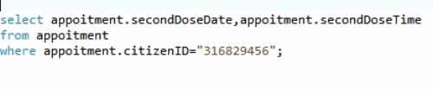
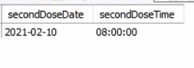
Queries
9) The date of the second vaccine dose for a specific citizen

Slide 25
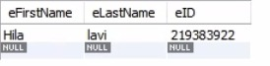
Queries
10) The nurse that had injected the most vaccine doses

Slide 26
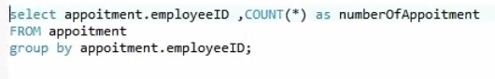
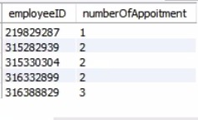
Queries
11) How many appointments were scheduled by a specific secretary?

Slide 27
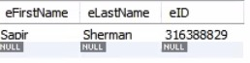
Queries
12) The secretary who scheduled the most appointments

Slide 28
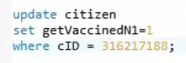
Update:

Slide 29
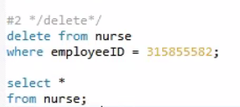
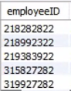
Delete :

Slide 30
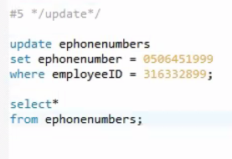
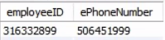
Update :

Slide 31
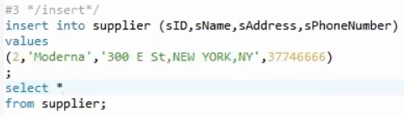
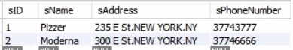
Insert :

Slide 32


Insert :

Slide 33



triggers
Before :
After :

Slide 34


Slide 35


Slide 36

COVID 19’ Vaccine ;The light at the end of the tunnel

